Slide 1
CSP + MDP + DL Minesweeper
David Kleppang
Eric Williams
Maegan Sobel
Foundations of AI (Spring, 2025)
Notes:
Eric David and Maegan and we did our foundations of ai project on solving a game of minesweeper with CSP, MDP, and Deep learning

Slide 2
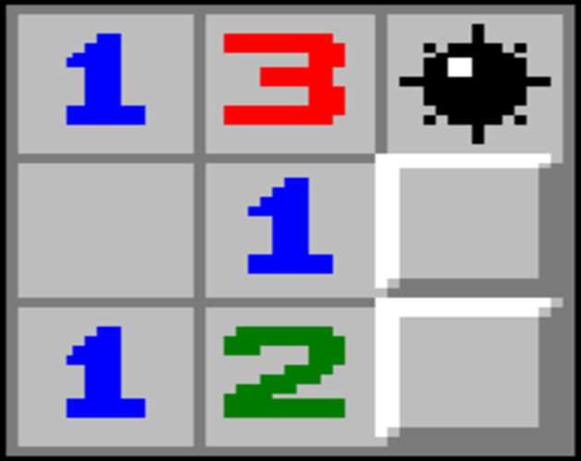
Problem
Minesweeper is a game played with hidden cells where some are safe and some are mines. Selecting a mine ends the game, but selecting all safe cells is the winning state. A safe cell will reveal clues to the location of adjacent mines.
Main Assumptions:
Rewarding behavior for maximizing revealed cells per turn should lead to model beginning to win
Punishing redundant moves and losses should prevent the model from losing and making poor choices
Figure 1. Classic Minesweeper
Notes:
Probably familiar with the game of minesweeper but you might not know the rules.
It’s a grid of cells where each cell you click reveals the number of mines on cells next to it as well as any cells that have no mines next to them
One strategy that could be employed to win a game of minesweeper is to maximize the number of cells revealed per turn, I.e. picking cells that are likely to reveal the most squares
Additionally, choosing cells that are likely to have a mine should be punished

Slide 3
Context – Why CSP and MDP?
Minesweeper is a game played with hidden cells where some are safe and some are mines. Selecting a mine ends the game, but selecting all safe cells is the winning state. A safe cell will reveal clues to the location of adjacent mines.
CSP techniques allow for inferences based on logic. This works well for learning the strategies in Minesweeper, however, there are situations in the game where pure logic is insufficient.
MDP helps us teach probability models that allow our AI to make the best-case decision in the absence of clear direction.
Figure 1. Classic Minesweeper
Notes:
For this project we used Constrain satisfaction problems to model make state decisions,
Csp: Gather constraints from all uncovered cells. Define obvious mine locations, and select a location that is statistically the safest
If there is a case where the safest cells provide the same level of risk, a Markov decision process to track the probabilities from previous runs to make the best case decision

Slide 4


Why CSP and MDP for Minesweeper
Incomplete info + strategies = good test for AI
Each revealed cell knows its neighbors' constraints (CSP)
Decisions with missing information (MDP)
Deep learning
ThePhoto by PhotoAuthor is licensed under CCYYSA.
Notes:
Minesweeper is played with incomplete information but can be solved with learned strategies, making it a great game to test AI.
Each revealed number represents a constraint on a neighboring cell. This enabled us to utilize the Constraint Satisfaction Problem (CSP) to help train our AI how to solve for the winning strategy.
The Markov Decision Process (MDP) is used when the AI has to make a decision when given uncertain parameters. Given that Minesweeper is played with incomplete information, this is a great method to implement to help train our AI to make the best decision.
Deep learning methodologies enhances the utilization of CSP and MDP making it an efficient and effective learning model for solving Minesweeper.

Slide 5
Problems During Training
Training Deep Learning to CSP
Large dataset is required.
Constraints Storage-heavy
CSP = deterministic, DL = approximation (conflicting goals
How to reinforce decisions made in uncertainty using MDP
Probabilities improve with more iterations
Wrong moves made early in the game may lack context
Reinforcement learning without enough context
>1,000,000 instances
Training from scratch is computationally expensive
Randomization of the Minesweeper gameplay
Any grid size; the learning model should translate and be scalable
Strategies for one board may not work for another size
Notes:
Training Deep Learning to CSP
To learn the game, a large dataset is required.
Labeling every constraint is storage-heavy
CSP and Deep Learning can occasionally have conflicting goals
CSP = deterministic, DL = approximation
How to reinforce decisions made in uncertainty using MDP
Since there are instances that may require guessing (logic absent), and the board is only partially observable, MDP may not have the required probabilities established to make a meaningful guess
Wrong moves made early in the game may lack context to contribute to our Deep Learning and Probability models
Reinforcement learning without enough context
Some models require an extremely high number of training instances (hundreds of thousands, or millions) to generalize efficiently
Training from scratch is computationally expensive
Randomization of the Minesweeper gameplay
Minesweeper can be trained on any grid size, meaning, the learning mo

Slide 6
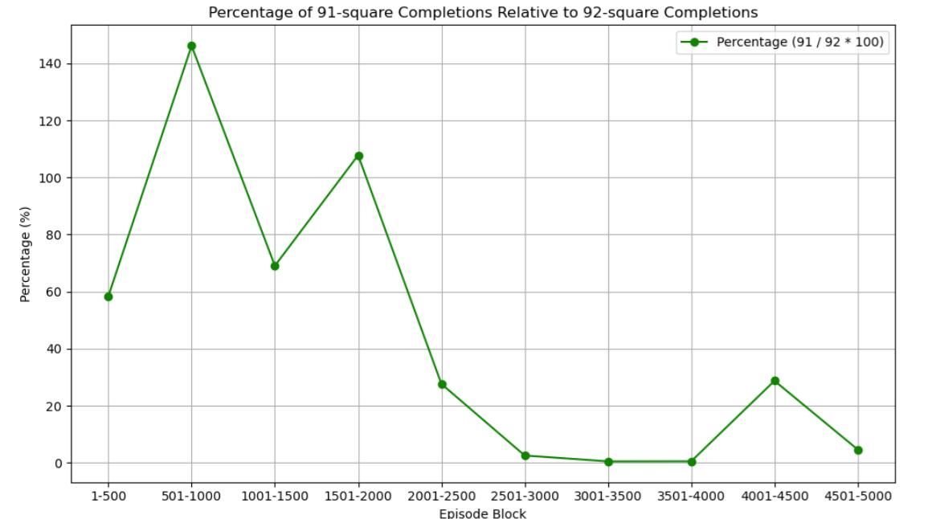
Problems During Training (Contd.)
Catastrophic forgetting observed during early stages of model development (10x10 board with 8 mines)
Polyak averaging solved this problem
Notes:
One of the biggest problems we ran into was catastrophic forgetting where after the model started winning for a few thousand episodes, it would forget what it would learn and lose a bunch of games. In the end, Polyak averaging solved this problem by averaging parameters over multiple iterations so that one large weight change would not break the next sequential runs

Slide 7
Overview of Solutions
Training Deep Learning to CSP - Solution
We ran the learning model over a variety of episode counts – 2,000 | 5,000 | 10,000
We utilized a mapping solution, constraint adjacency list (of two data points in the tuple), forced checks, and a keyed mine probability. For a 10x10 board, this was sufficiently fast.
If we needed to increase efficiency for a larger board, we could choose to not store every list of solutions in memory
Our hybrid approach that included the Markov Decision Process (MDP) mitigated conflicting options
How to reinforce decisions made in uncertainty using MDP - Solution
We utilized DQNs (Deep Q-Networks) to learn from past mistakes
We implemented a target network that helped our model level some of the extreme cases and reduce assumptions from extreme risk/reward outcomes

Slide 8
Overview of Solutions
Reinforcement learning without enough context – Solution
We trained the AI on a smaller board size (10x10 with 8 mines)
We immediately implemented our reward system to reinforce good and bad decisions
We implemented heavier penalties for losing the game and much higher reward for winning
Randomization of the Minesweeper gameplay – Solution
Even if the mine density stayed the same, increasing the board size lowered the win ratio regardless.
We successfully trained the AI to solve the minesweeper board with the mines randomly placed

Slide 9
AI Model(s)
Our AI model combines the use of Deep Learning, Constraint Satisfaction Problems, and Markov Decision Processes to form a hybrid problem-solving model
Deep Reinforcement Learning (DRL) enhances our MDP to make the best decision
Balancing of risk and reward where CSP is not enough
MDP is used when uncertainty is present
If guessing is required, our model uses MDP and the Deep Learning model to make the best-case choice
Our final model utilizes hybrid methods to solve the board
CSP for logic-based decisions
MDP for risky moves that lack context
DRL for estimation and assessment of risk

Slide 10
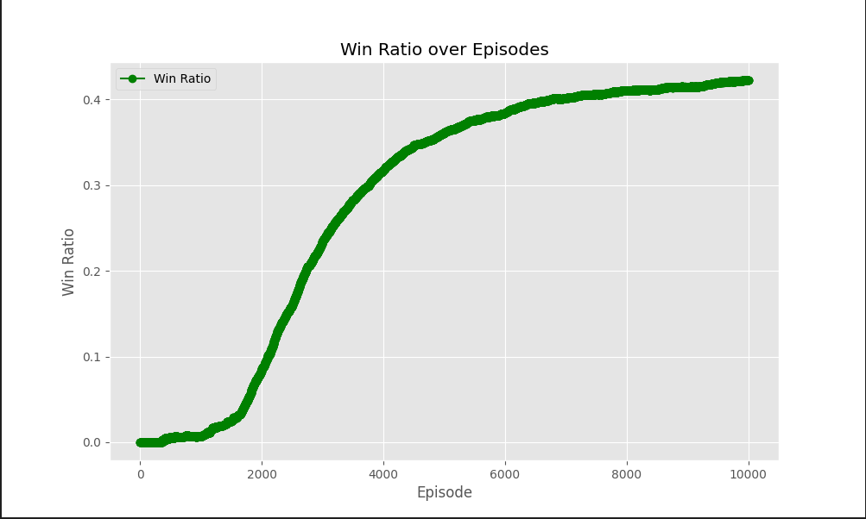
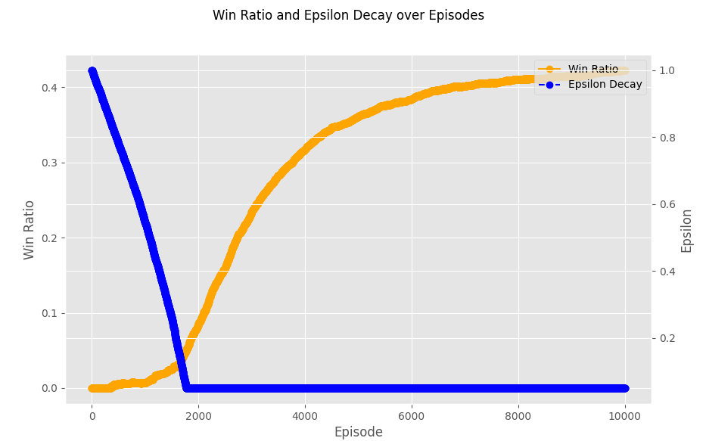
Evaluations – Performance
Final Win Ratio was 42.4% over 10,000 episodes
Our win ration is defined as:
Win Ratio = (Games Won)/(Total Games Played)

Slide 11
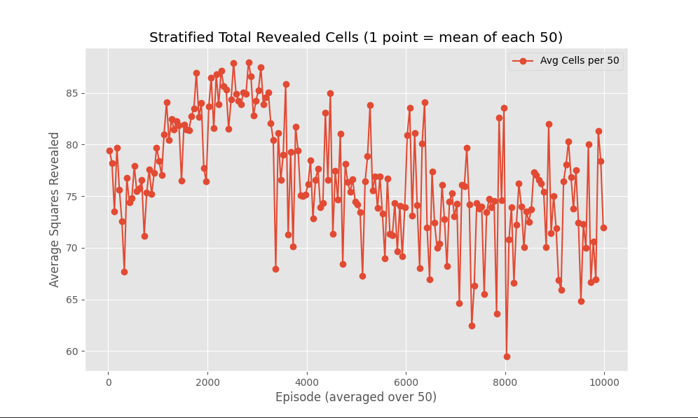
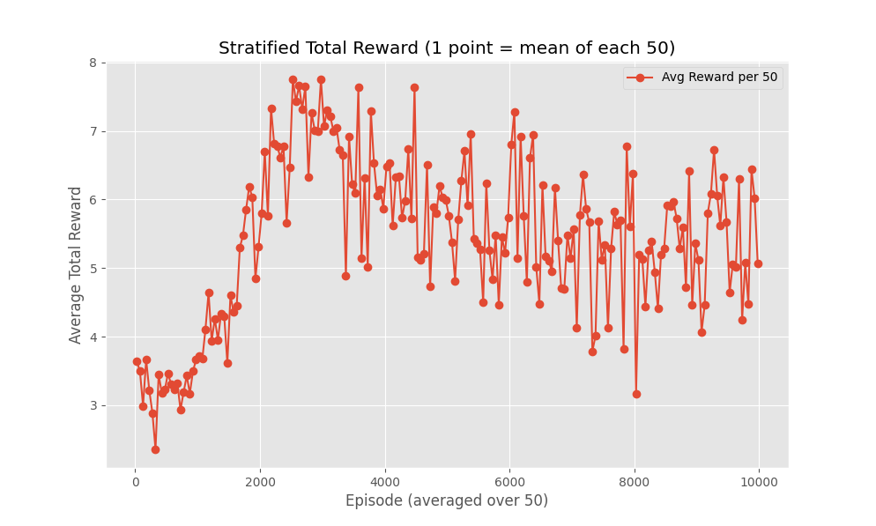
Evaluations – Performance
Cells Revealed vs Unrevealed (Progress)
Higher exposure rate indicates better decision-making
We can assume the AI avoids unnecessary guessing if the exposure rate increases
Increased exposure rate as training continues shows improved efficiency in the model

Slide 12
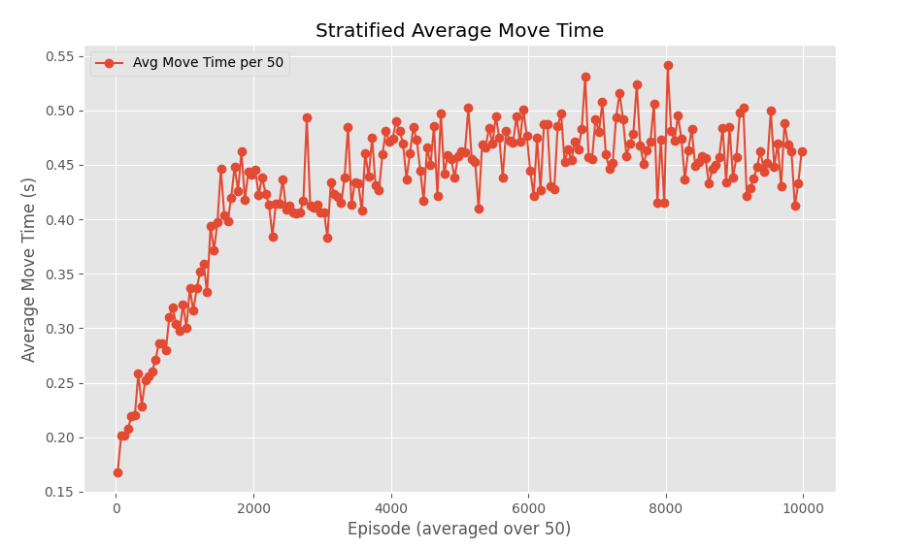
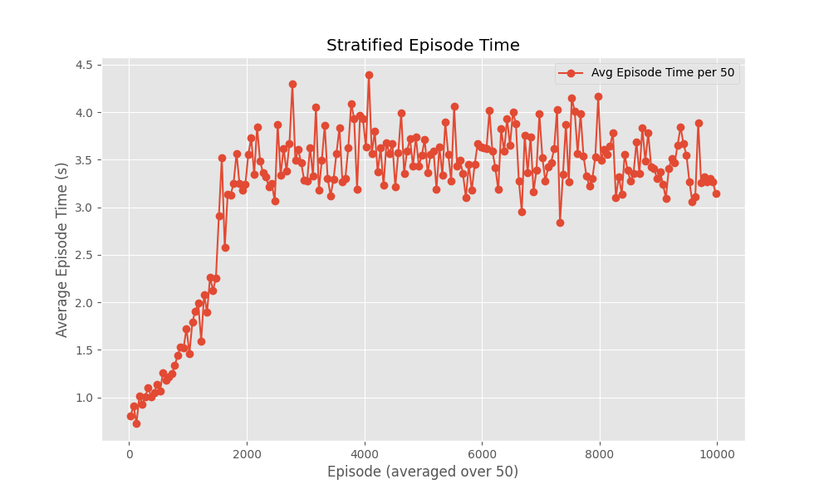
Evaluations – Performance
Average Time per Move / Episode
Lower time implies better computational efficiency
The initial 0-2000 episodes are important to note in context

Slide 13
Discussion of Results
All of our data showed an initial performance increase, but an ultimate plateau
The plateau in performance shortly after epsilon decay could point to diminished returns after the training period, settling on a sub-optimal policy, and reduced ability to test after the training period and continue to develop winning strategies.
We could potentially resolve this by extending the training period and slowing the decay of our epsilon value, allow for milestone increases in the epsilon value which, in turn, allows for more risk during testing, or continuing to tune the parameters like our penalty/reward values as we saw some opportunities to do so in the cells revealed/reward totals visuals.

Slide 14
Demo (see Kaltura)
https://psu.mediaspace.kaltura.com/media/%5BDavid+Kleppang%5D-%5BMaegan+Sobel%5D-%5BEric+Williams%5D-slides/1_2vkn8gdb

Slide 15
Conclusion
By combining Deep Learning, CSP, and MDP, we’ve created a hybrid learning environment to train an AI to solve Minesweeper effectively. This approach was informed by Sinha et al. (2020).
The AI adapts to various board configurations.
Replaces brute-force or pure-random play with experience-driven strategies
Expanded on Sinha's approach by incorporating Polyak-averaging
We believe a hybrid model such as this is the most effective reinforcement learning method for mastering Minesweeper
CSP: For certain, safe moves.
Deep Learning: For recognizing context
MDP (Q-Learning): For strategic choices under uncertainty

Slide 16
References
Figure 1
Custom Minesweeper Board. (2025). Itch.io. https://juuldev.itch.io/custom-minesweeper
Sinha, Y. P., Malviya, P., & Nayak, R. K. (2021). Fast constraint satisfaction problem and learning-based algorithm for solving Minesweeper. arXiv. https://doi.org/10.48550/arXiv.2105.04120
Code: https://github.com/ekw5123/801-AI-game

